Slide 1
How to lose weight and keep it off with ADHD
With Maranda Stone, MS, RD, CSOWM, CLC

Slide 2
My background
Registered Dietitian Nutritionist for over a decade
Bachelor’s and Master’s degree in Nutrition Science
Board Certified Specialist in Obesity and Weight Management
Certificate of training in Childhood and Adolescent Weight Management
Over 5000 hours working with 300+ patients on weight loss
Certified Life and Health Coach
Specialize in working with emotional barriers/patterns that prevent long term change
Have my own private practice specializing in weight management and ADHD
I have ADHD

Slide 3
Adhd and body weight
People with ADHD are 70% more likely to struggle with their weight
Executive Function | Meal Planning Shopping Cooking
Emotion Regulation | Getting cranky, irritable or sad when hungry Eating to help boost dopamine or from boredom
Impulse Control | More likely to eat the cookie, have that second helping, or eat too fast
Medications | Suppressed appetite during the day can lead to evening binging
Body awareness | Many people with ADHD are less aware of their own hunger and fullness cues
Hyperfocus and Distraction | Forgetting to eat when you are “in the zone” Or eating too much without noticing

Slide 4
outline
Nutrition principles of weight loss
ADHD specific strategies
Meal planning
Emotion regulation
Impulse optimization
Other considerations
Q&A
*This specific presentation is geared toward adult nutrition only. If you have weight management concerns with a child, please consult directly with a dietitian.

Slide 5
Medical disclaimer
Everyone’s body has different needs that will depend on health conditions, metabolism and level of physical activity
Everyone experiences ADHD differently. Strategies that work for someone else may or may not work for you.
Please consult with your doctor or dietitian before making significant nutrition changes, especially if you have any health issues including being on warfarin or diabetes medications
Medical nutrition therapy (where a dietitian gives you advice based on your specific health conditions) can only be done in a one on one setting where the dietitian has access to your medications and health conditions and can tailor recommendations to you

Slide 6
Why Diets don’t work
Too extreme
Too hungry
Too boring
Too much exercise
Not the way you normally eat
They confuse your body and long term make things WORSE
INCREASE hunger hormones
SLOW your metabolism (make it easier to gain weight in future)
INCREASE binging or disordered eating habits
LOWER muscle
Diets work AGAINST your body, not WITH it

Slide 7
Long term sustainable weight loss
1) Learn to listen to your body instead of trying to control or change your body.
2) Sustainable = Immediate dopamine/feel good reward (not delayed gratification)
Eat food that you genuinely ENJOY that supports your health
Move in a way that you LIKE that feels good WHILE you are doing it
3) Challenge your assumptions of what this has to look like for you

Slide 8
Nutrition principles of weight loss
Would weight loss be helpful for you?
What health conditions do you have? Would they be improved with weight loss?
What lifestyle do you want to live? Would this be improved with weight loss?
BMI- pros and cons, doesn’t take into account muscle mass, etc
https://www.nhlbi.nih.gov/health/educational/lose_wt/BMI/bmicalc.htm
If yes, how many calories per day do you need?
https://www.leighpeele.com/mifflin-st-jeor-calculator to find TDEE (today daily energy expenditure) and then subtract 500-700 calories from that number to get what the estimated amount of calories you need to start losing weight*
For MAJORITY of people it is accurate within 10% (dietitian can help if not accurate)
Resting Metabolic Rate testing
*If that calculation takes you below 1200kcal per day, please consult a dietitian first

Slide 9
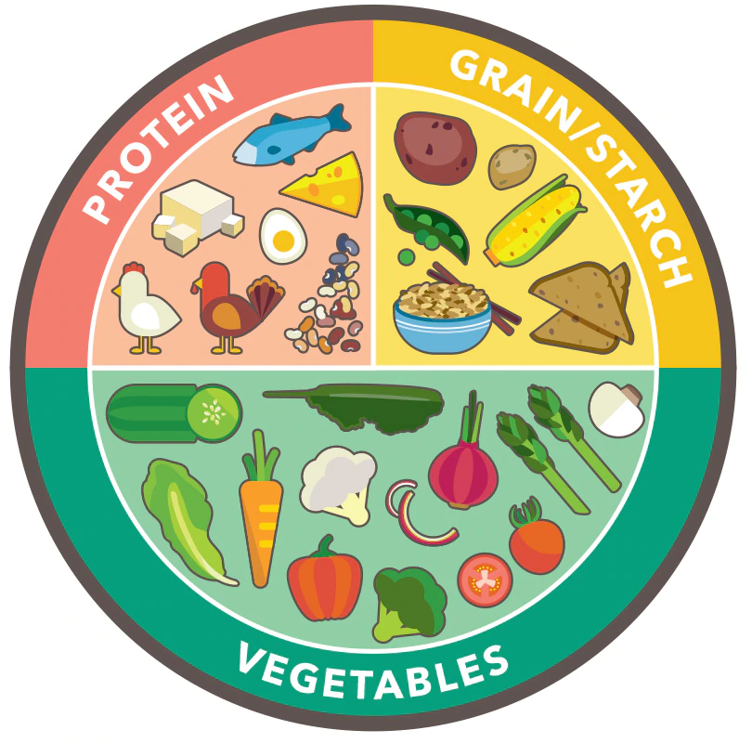
Nutrition principles of weight loss
Macronutrient daily distribution
25-35% of calories from protein (minimum 65g, 0.8g-1.2g/kg current body weight, in case of obesity IBW is used)
45-55% calories from carbohydrates (not going below 120g)
25-35% calories from fat (not going below 35)
Eating 3 balanced meals per day, balanced snacks as needed
Adequate fluid intake (varies a lot- 65-120 oz)
*These recommendations can vary significantly with medical conditions, age, severity of obesity, and if you have high levels physical activity

Slide 10
Aim for 80% of what you eat to be healthy
 | Proteins | Carbohydrates | Non-Starchy Vegetables | Fats (moderation, high calorie)
Healthy | Fish, eggs, lean chicken and turkey, low-fat dairy | Fruit, whole wheat (bread, pasta, crackers, etc), brown or wild rice, corn, peas, sweet potatoes, beans, oatmeal | All of them (note- corn, peas, potatoes, and beans are considered carbs not non-starchy veg) | Avocado Oil EVOO Nut butters Hummus
Less Healthy | Beef, pork, full fat meats, salami’s, lunch meats, hot dogs, full fat dairy | sweets, refined sugar, added sugars, fruit juices, refined wheat (bread, pastas, crackers, etc), white rice, white potatoes | Deep fried vegetables | Heavily refined seed oils Most saturated fats (in milk, meat, baked goods, and restaurant food)

Slide 11
Food label Basics
The more processing something has been through, the less healthy it typically is
Look for shorter food labels, full of real healthy food ingredients that you recognize
The more chemicals or “added sugar” is in something, the less good it is for you

Slide 12
Tracking
Should I be tracking my food?
Not a necessity
If stuck, can be helpful to temporarily track (a couple weeks) to see where you are at and what habits/patterns to shift
Caution in tracking if
History of eating disorder or anxiety around food/body weight
If it feels triggering, don’t do it without the support of a dietitian
Tracking apps:
Phone options
Baritastic
Not a long term solution, purpose is data collection to inform changes
Try working on habits first

Slide 13
Rate of weight loss
BMI 25-29: up to 1 lb per week
BMI 30-40: 1-2 lbs per week
BMI 40-49: up to 2 lbs per week
BMI: 50+: potentially fasted based on medical evaluation (often 3-4 lbs per week)
Losing too fast will slow your metabolism and make the weight long term more likely to come back

Slide 14
Shopping and cooking with adhd

Slide 15
Cooking and executive function
Cooking | Not cooking
Deciding what you want to eat Making a plan for the week Evaluate what foods you already have Creating a shopping list Doing the actual shopping Preparation- did I remember to pull the chicken out of the freezer last night? Remembering intention to cook Following the recipe Do I (and anyone else I’m cooking for) even like what I made…?? And now I have to do dishes!! Do I have enough energy or executive function for this??? | Order takeout

Slide 16
Reduce executive function demands
Task | Ideas to reduce executive function
Deciding what to eat | - Keep a written list of balanced meals you like (ideally protein, carb, veggie). Keep the list on the fridge and add to it when you think of it.
Making a grocery list | Whiteboard on fridge, write down items as you run out or low, take a pic Grocery list apps (whole family can access) Automatic grocery lists (covered in future slide)
Shopping | Grocery pickup or delivery (King Soopers has 50% off deals where you can get unlimited free next day deliver for a year for around $50) Also helps with avoiding bringing impulse buys into the house

Slide 17
Cooking Strategies: no cook options
Create a list of balanced meals and snacks that you like that don’t require any cooking
Examples: Healthy choice power bowls/steamers, items from prepared section of grocery store, oikos triple zero Greek yogurt, string cheese and fruit, frozen breakfast egg white/turkey cups, hummus and triscuits, P3 pack, healthy takeout options (ex- some Mod Market bowls, etc), premade meal delivery kits, etc.
Minimum a protein and a carb at each meal and snack, ideally include a veggie
Actively learning a new skill takes more executive function. So if cooking is challenging, we want to expand slowly

Slide 18
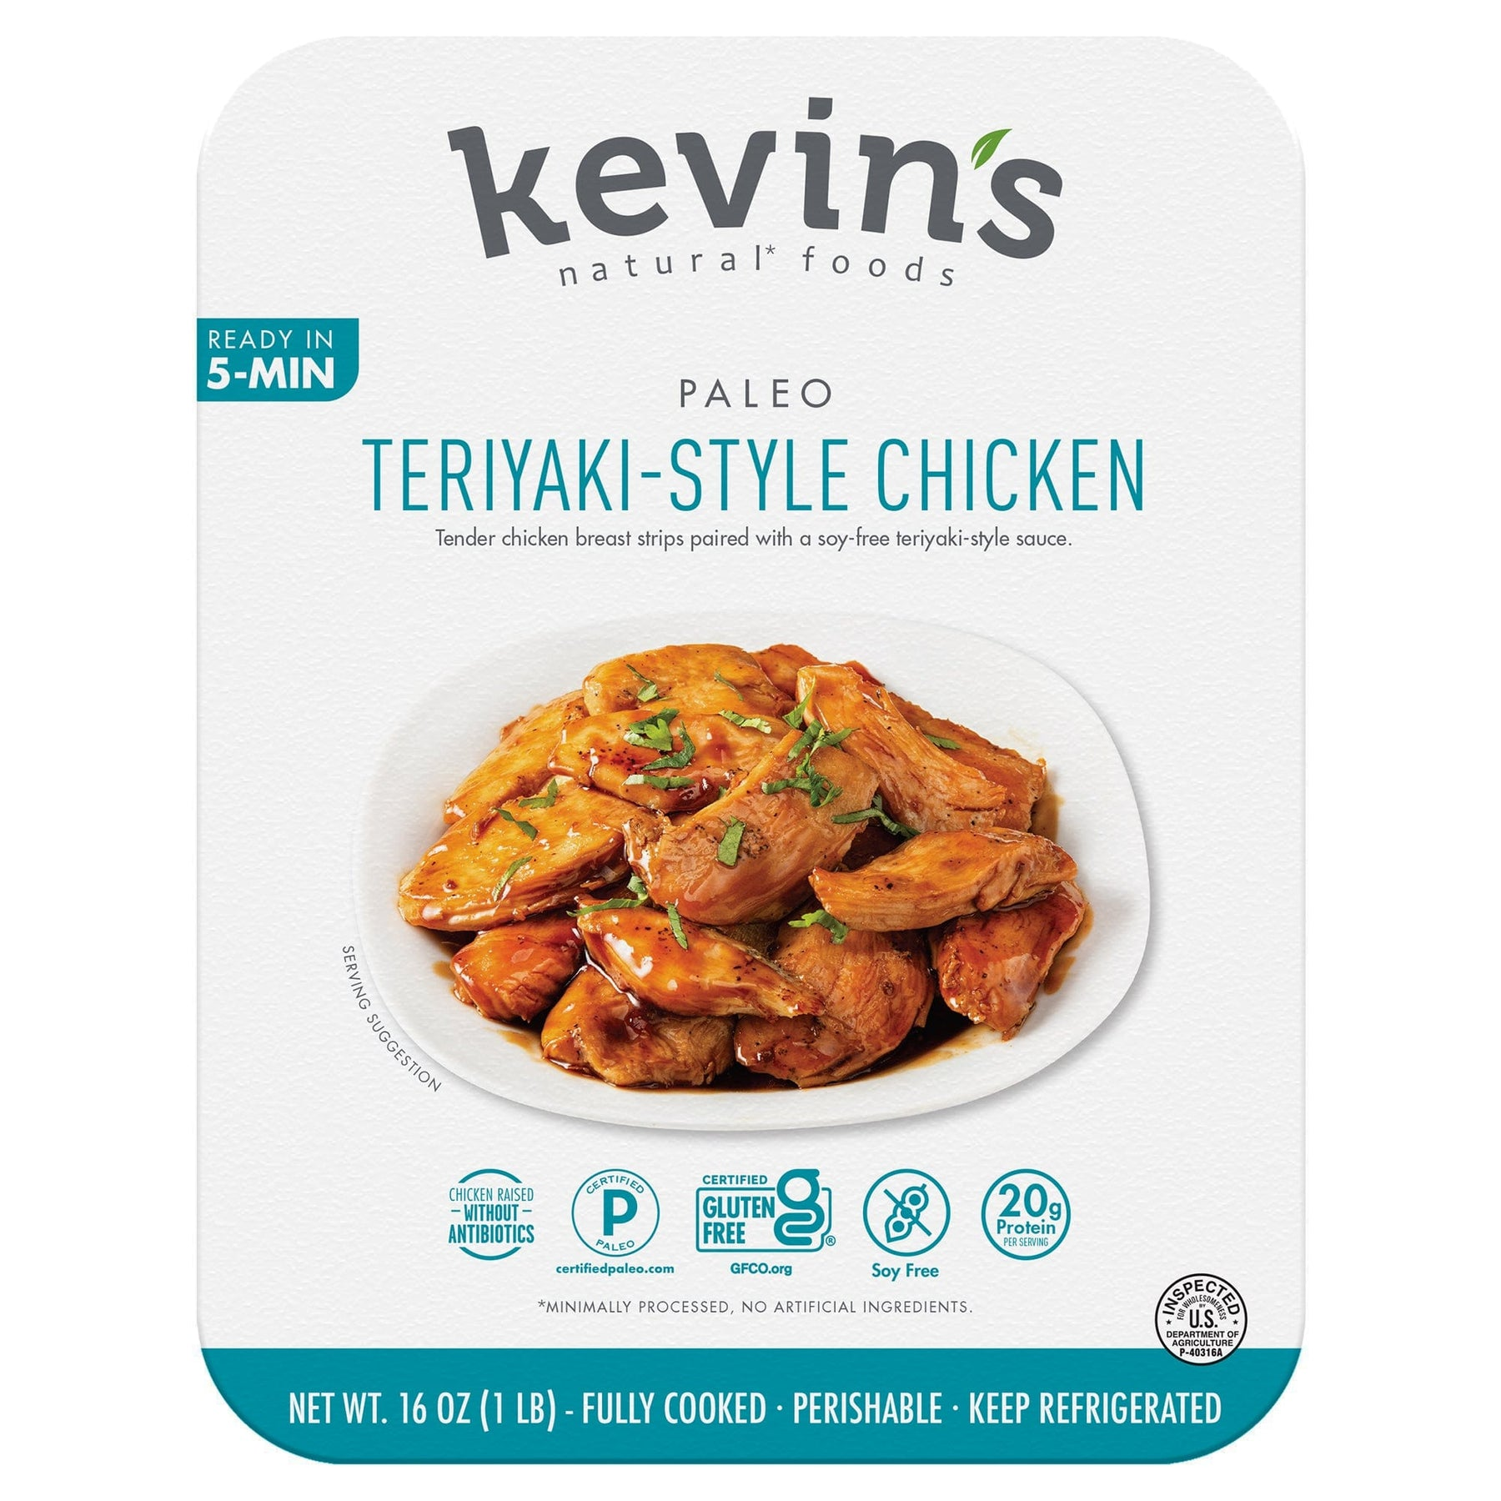
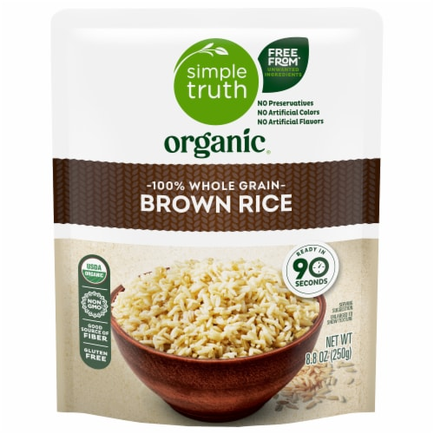
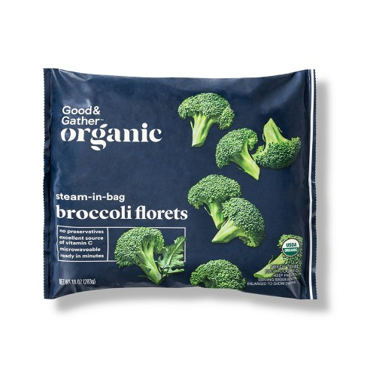
Strategies: minimal cook options
First step: 5 minute recipes
Kevin’s Meals + 90 second rice + microwaved steamed veggie
Hungryroot- 5 min or less recipe options
Pre-seasoned/marinated raw meat at the deli + salad + microwaved sweet potato
Pre-prepared meat + salad (arugula + dressing) + piece of fruit
Sandwich (whole wheat bread + pre-pulled rotisserie chicken + lettuce/tomato)
Second step: choose one item to expand upon
Example: instead of using microwaved steamed broccoli, buy pre-cut broccoli, put in a bowl and toss with oil, salt, pepper and roast in the oven – less than 5 min prep time for this item)
Third step: 15 min or less recipes
5 ingredient cookbooks
Instant Pot recipes that require minimal chopping
And continue expanding in this way until YOU are happy with the variety/quality of food

Slide 19
Meal planning
Take into account a realistic week
Calculate your approximate calorie and protein needs per meal
Example: 2000 kcal per day
500 kcal per meal (x3)
250 kcal per snack (x2)
REUSE them
Grocery ordering: create a “shopping list” for each meal plan or recipe

Slide 20
Grocery list example

Slide 21
EMOTION REGULATION

Slide 22
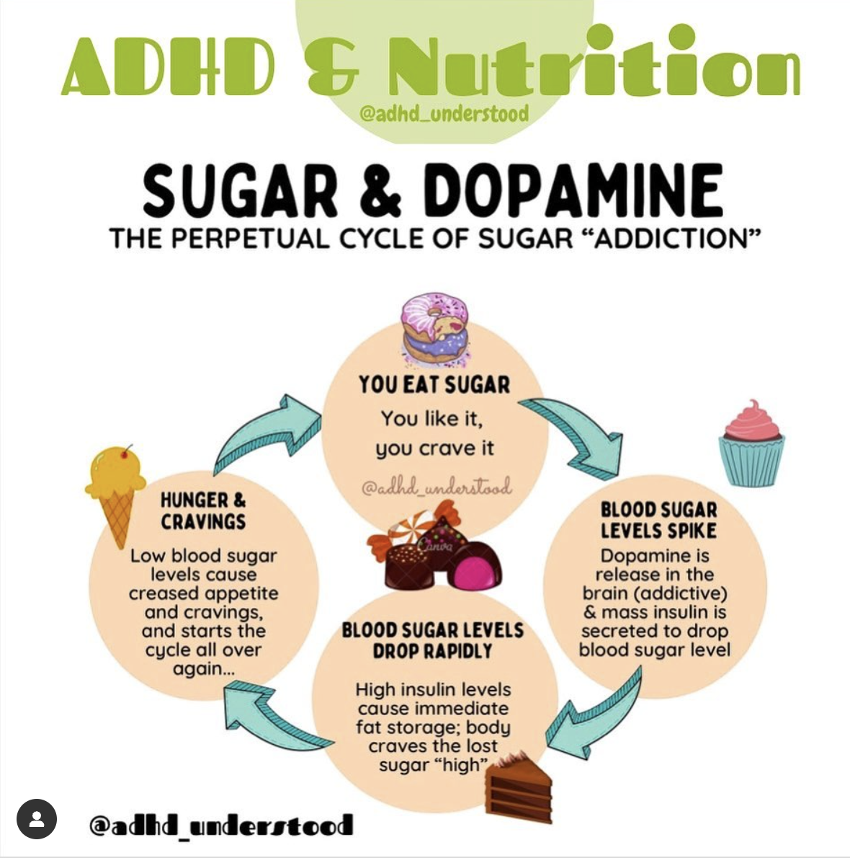
Dopamine and food
High sugar, high fat, and many processed foods stimulate the “reward” center in the brain but only temporarily
It is then followed by a crash, and then more cravings
Irritability, difficulty focusing, fatigue, grogginess, drop in dopamine
SIGNFICANTLY impairs emotion regulation, energy, and focus in the long run
These foods “hijack” your energy systems
Shoots dopamine too high and then way back down
Desensitizes your brain to the dopamine, so that you need more to experience the same effect, but in the long run making you feel worse

Slide 23
AHDH and the nervous system
Heightened nervous system sensitivity
Can experience environmental stimuli, emotions, and body sensations more intensely
These can lead to overwhelm and, at times, disconnection from those systems to assist with regulation
What does this mean for food?
We are more likely to get dysregulated when we are hungry or not eating properly
We are also less likely to notice we are hungry in the first place

Slide 24
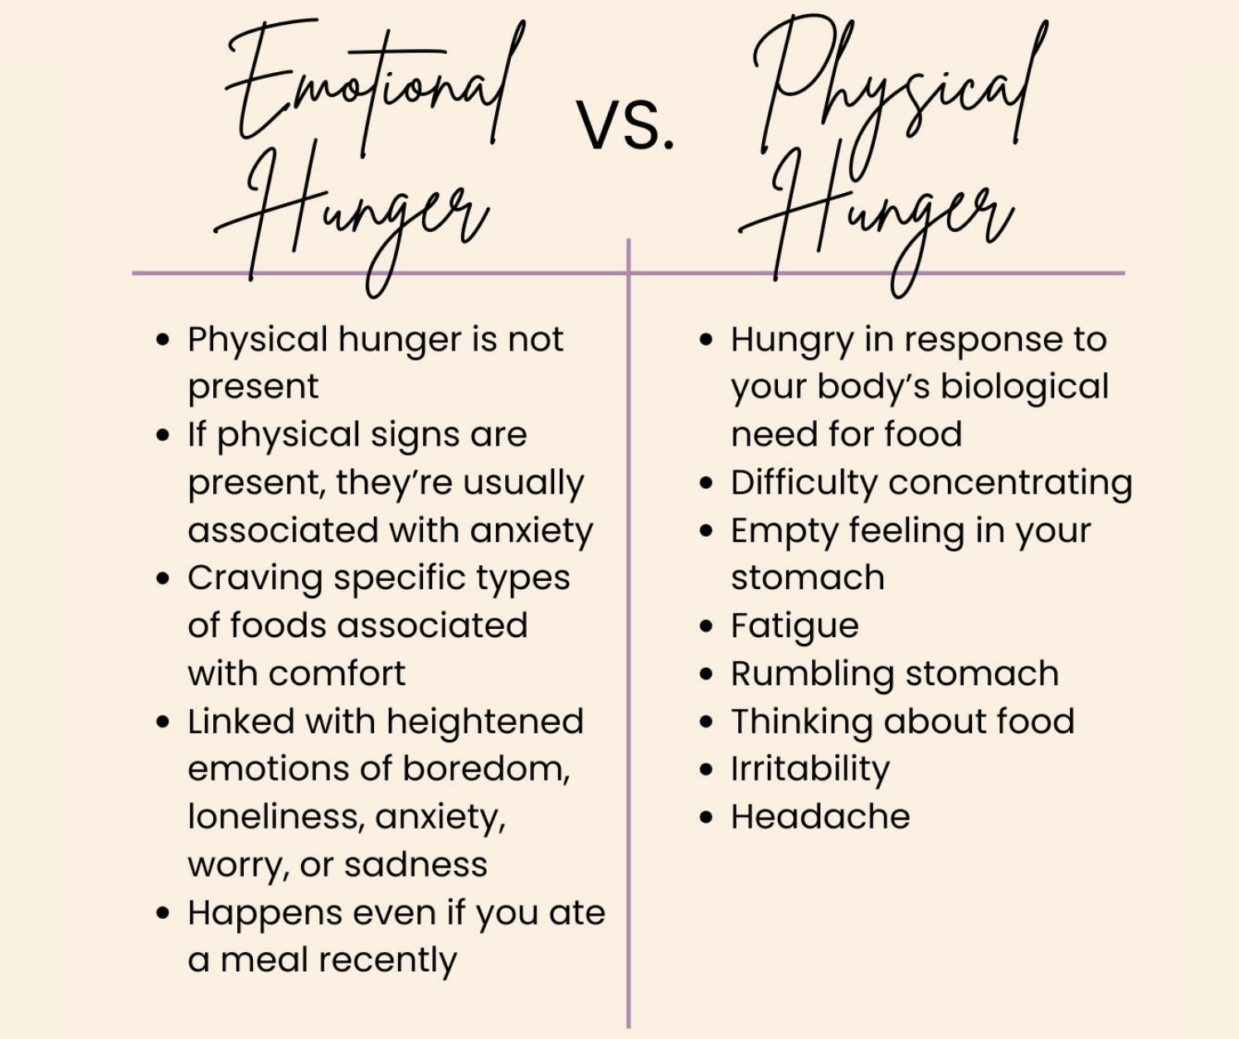
Hunger scale

Slide 25
Optimize your impulses

Slide 26
Impulse optimization vs impulse control
Instead of trying to exercise “control” set up your environment so that your impulses drive you naturally toward the things you WANT to be doing

Slide 27
ADHD friendly kitchen
Out of sight is out of mind- for both healthy and less healthy food
Put things out on the counter that you WANT to be choosing
Healthy choices that you actually LIKE
If you hate apples, don’t put apples on your counter…. doesn’t matter how healthy it is, if seeing releases a negative emotion instead of a positive one, find something else to put there
Use clear jars/containers for things you want to be eating
Remembering it is there
Impulse to consume it
Veggie crispers
Is this where veggies go to die in your home? It is in mine!!!
Pantry
Sweets and unhealthy foods

Slide 28
Additional considerations
Weight loss medications
Bariatric surgery
Eating disorders
Celiac
Gluten and dairy sensitivity
MTHFR genetic mutation
Labs and supplements

Slide 29
Additional considerations
Recommended Labs | Supplements to Consider
CBC and CMP Lipid Panel Vitamin D Iron panel (with serum ferritin) MMA and/or serum B12 Thyroid function (TSH, Free T4, Free T3 and antibodies) Celiac panel RBC magnesium Plasma or RBC Zinc MTHFR genetic mutation (optional) | Vitamin D, iron, and zinc IF DEFICIENT Magnesium glycinate- max total supplemental magnesium 400mg/day (supportive in general, also stimulants can deplete) Methylfolate – potential MTHFR (ex: Life extension bioactive Folate and Vitamin B12”) Omega 3 fatty acids (ask your doctor) Ideally get supplements from a USP, NSF, or third party tested brand (like NatureMade)

Slide 30
finding support
Dietitian Support
Everyone deserves support with food
Due to the affordable care act, many insurances include dietitian visits under “preventative care” which CAN mean free or very low cost appointments
Often do not need a health diagnosis for coverage
Additional support:
Therapist
Physician and/Psychiatrist
Coaching

Slide 31
Questions??
Link to Presentation
Maranda Stone, MS, RD, CSOWM, CLC
Email: mstonenutrition@gmail.com
Phone: 720-507-6605
Address: 338 Main St. Longmont
Website: Discoverfoodfreedom.com
Or go to Discoverfoodfreedom.com/ADHD

